Slide 1
NURA Project Data Update
4/26/24

Slide 2
Purpose
I am investigating the effect of mTBI in finer detail by looking at WM recall and recognition in both blocked and intermixed trials. I am also recording participant’s levels of impulsiveness to see whether it varies between groups/relates to differences in WM performance.

Slide 3
Demographics (N = 26)
Age M(SD): 20.0(1.78)
Gender: 8 males, 17 females, 1 other
mTBI n = 9
Control n = 17

Slide 4

Recognition Trial
Task Diagram (BLOCKED and INTERMIXED blocks)
SOA: 400-500 ms
100 ms
900 ms
Response (3000 ms)
SOA: 400-500 ms
100 ms
900 ms
Response
Recall
Trial

Slide 5
Recognition Data (N = 26)
Error bars represent 95% CI

Slide 6
Recognition Data x Group
(mTBI n = 9, control n = 17)
Error bars represent 95% CI

Slide 7
Recognition Data Over Time
(N = 26)
Error bars represent 95% CI

Slide 8
Recall Data (N = 26)
Error bars represent 95% CI

Slide 9
Recall Data x Group
(mTBI n = 9, control n = 17)
Error bars represent 95% CI

Slide 10
Recall Data Over Time
(N = 26)
Error bars represent 95% CI

Slide 11
BIS – Brief x Group
(mTBI n = 9, control n = 17)
mTBI M(SD): 16.7(3.39)
Control M(SD): 16.0(3.12)
BIS-Brief: Barratt Impulsiveness Scale – Brief, scores range from 8-32
Error bars represent 95% CI

Slide 12
Recognition Data x BIS-Brief (N = 26)
BIS-Brief: Barratt Impulsiveness Scale – Brief, scores range from 8-32

Slide 13
Recall Data x BIS-Brief (N = 26)
BIS-Brief: Barratt Impulsiveness Scale – Brief, scores range from 8-32

Slide 14
Recognition Data x BIS-Brief x Group
(mTBI n = 9, control n = 17)
BIS-Brief: Barratt Impulsiveness Scale – Brief, scores range from 8-32

Slide 15
Recall Data x BIS-Brief x Group
(mTBI n = 9, control n = 17)
BIS-Brief: Barratt Impulsiveness Scale – Brief, scores range from 8-32

Slide 16
A)
SOA: 400-500 ms
100 ms
900 ms
Response (3000 ms)
SOA: 400-500 ms
100 ms
900 ms
Response
B)

Slide 17
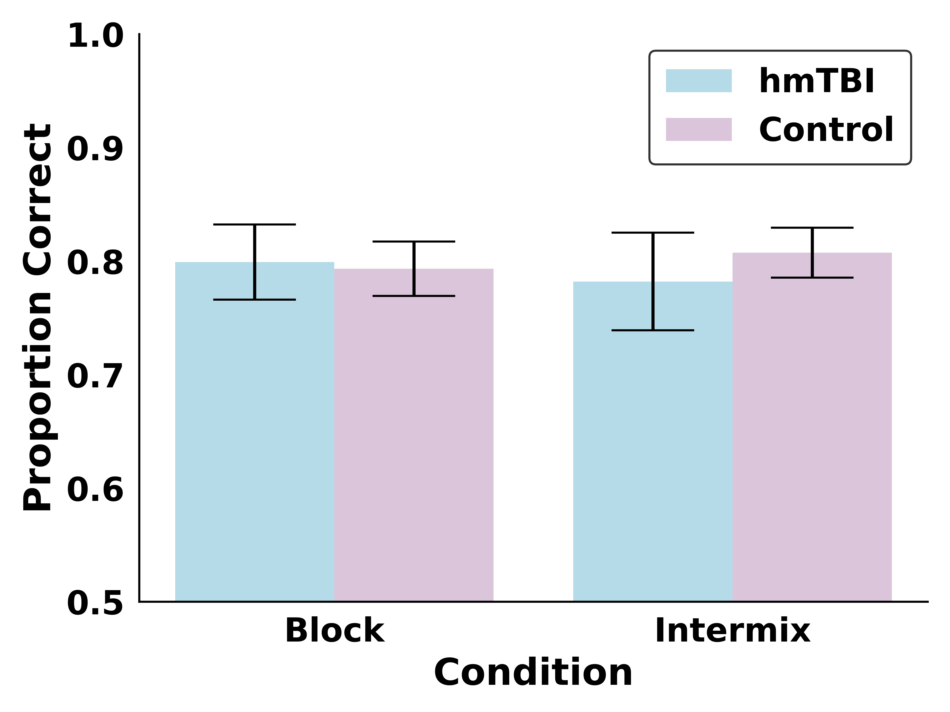
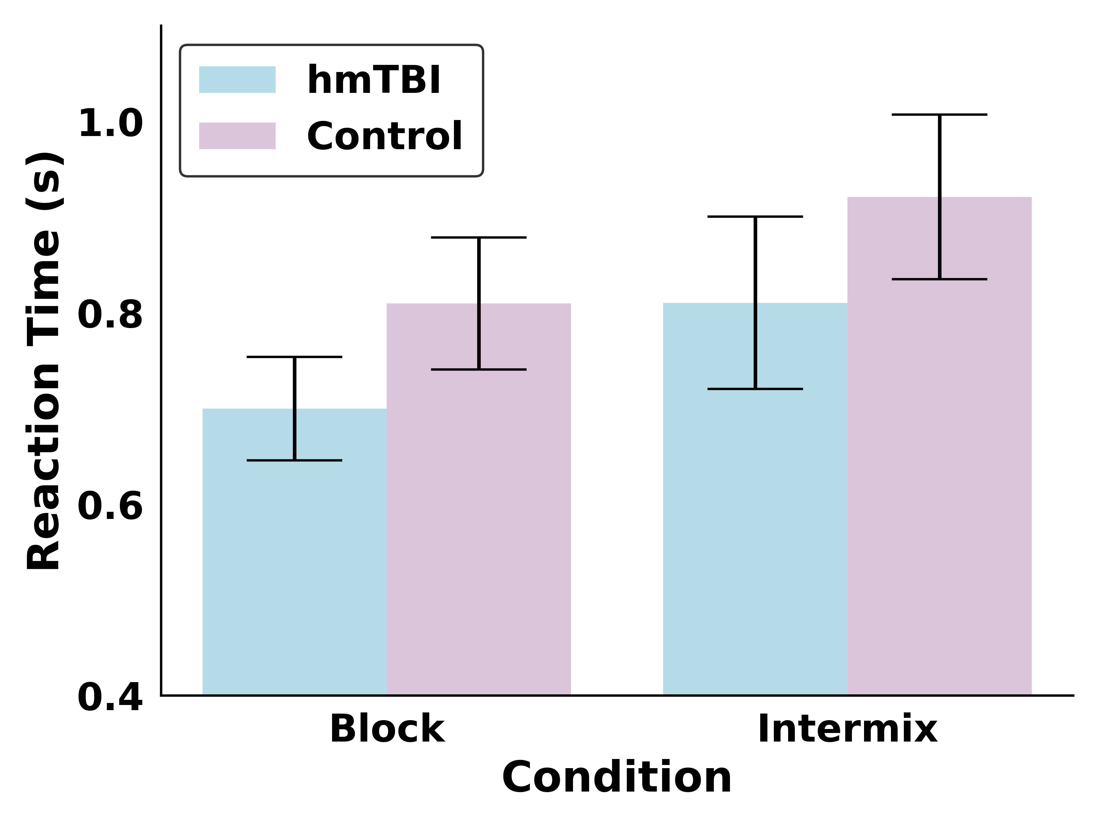
A)
B)

